Slide 1
Topic 6: Issues related to accounting for income and expenses
Reference:
Deegan, C,
Ch. 16, pp. 506-514; section 16.5
Ch 2, pp. 66-67

Slide 2
Objectives
Define and identify the criteria for the the recognition of income and expenses as specified in the AASB conceptual framework
Apply the framework definition and recognition criteria
Explain the difficulties in applying the framework definition and recognition criteria
Evaluate the framework definitions of income and expenses, and the recognition criteria in the context of financial reporting

Slide 3
Introduction
Owners invest money or other resources in a business. Income/expenses represent increases/decreases in that investment
We have studied the AASB framework elements of assets, liabilities and owners’ equity …
The notions of income and expenses are dependent on the definitions of assets and liabilities
Let us look at how these elements are defined in the AASB framework …

Slide 4
‘Income’ definition
‘… increases in economic benefits during the accounting period in the form of inflows or enhancements of assets or decreases in liabilities that result in increases in owners equity, other than those relating to contributions from equity participants, (AASB Framework for the Preparation … para. 70)

Slide 5
definition cont.
Linked to asset and liability definitions
  ‘inflows or enhancements of assets’: to qualify future benefit must be ‘controlled’ as a result of past event eg. accounts receivable resulting from credit sale
  ‘decreases in liabilities’: cancellation or settlement of an ‘obligation’ eg. Supply of magazines paid for in previous period
Must be an increase in owners equity (net assets) which is not a result of contributions by owners - WHY?

Slide 6
definition cont.
‘Income’ does not have to be earned. ‘Income’ includes ‘revenue’ and ‘gains’
  income: ‘arises in the course of ordinary activities’ eg. Sales, rent, interest
  Gains: ‘other items that meet the definition’ eg. Sale of non-current assets, revaluations, foreign exchange gains and losses, donations

Slide 7
Application of definition
The value of a pine plantation has increased as a result of the physical growth of the trees
Should income be recorded? (Is there an increase in an asset ie. economic benefit, control, past event?)
A vacuum cleaner was delivered to a customer ‘on approval’. The trial period expires after 20 days.
Should income be recorded?

Slide 8
Income recognition
To be recorded in the accounts ‘income’ must meet the framework recognition criteria:
  Probable - ‘more likely than less likely’
  Able to be measured reliably
Due to the difficulty of determining the point at which an asset or liability arises, and/or uncertainty, other regulation relating to the recognition of specific revenue has been introduced …

Slide 9
AASB 118 Revenue
Scope restricted to accounting for revenue arising from transactions and events relating to (para. 1):
  the sale of goods
  the rendering of services
  the use by others of entity assets yielding interest, royalties and dividends
Recognition criteria provided for each of the above categories of revenue …

Slide 10
AASB 118 Revenue: recognition criteria
Sale of goods: revenue to be recognised when all the following criteria are met:
  AASB Framework criteria (slide 8)
  The significant risks and rewards of ownership have passed to the buyer
  Costs incurred/to be incurred with respect to transaction can be measured reliably
  The entity does not retain managerial involvement or effective control over goods

Slide 11
AASB 118 Revenue: further recognition criteria
Rendering of services: revenue to be recognised when all the following criteria are met:
  When the stage of completion can be measured reliably
  Costs incurred and costs to complete can be measured reliably
  AASB Framework criteria (slide 8)

Slide 12
Application of recognition criteria
A refrigerator is delivered to a customer. The customer made a down payment of $50 and is expected to make monthly payments of $30 for the next 36 months. The customer’s credit rating is good.
Should any revenue be recorded? If so what amount and why?

Slide 13
Goods have been shipped by Co. A. Installation is a significant part of the contract and has not yet been completed by Co. A.
Should Company A record the revenue under the contract?

Slide 14
AASB 118 Revenue: measurement
Where payment is cash/cash equivalents, revenue is the amount received
In other cases revenue to be measured at the fair value of the consideration received or receivable (para. 9), for example
  Where an asset other than cash given as payment revenue is the fair (market) value of the asset
  If cash is not to be received for some period of time the future amount to be received would need to be discounted to its present value and the present value recognised as revenue (para. 11)

Slide 15
Evaluation of definition
Linked to asset and liability definitions and therefore subjective
  uncertainty of future economic benefit
  Past event giving rise to income and, therefore, point of recognition, often unclear eg. mining company: Extraction, shipment, delivery, cash receipt?

Slide 16
Evaluation of recognition criteria:
‘Probability’ subjective eg. insurance claims
Reliable measurement
  Not defined - different perceptions
  Inconsistencies
Inconsistencies in practice:
  foreign exchange gains and gains on biological assets recognised as income; increases in ‘property, plant and equipment’ values are not
  Let us look at recognition in relation to different points in the “earnings cycle” …

Slide 17
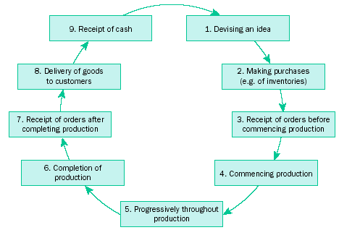
The earnings cycle (Coombes and Martin, 1982)

Slide 18
The earnings cycle cont.
  Traditionally, revenue has been recognised at several points in the earnings cycle (refer to Figure 16.1 (Deegan text) reproduced on previous slide), for example:
    (i) at point 5 (progressively throughout production) in the building industry for long-term construction contracts
    (ii) at point 7 (receipt of orders after completing production) where it is the responsibility of the purchaser to collect the goods
    (iii) at point 8 (delivery of goods to customers)—in most cases. Any uncertainty remaining is accounted for by creating a ‘provision for doubtful debts’

Slide 19
The earnings cycle cont.
    (iv) at point 9 (receipt of cash) by some professional practices and for installment credit sales
  Rarely, if ever, recognised prior to point 5 (progressively throughout production)
    - Uncertainty surrounding the claim to cash (or its equivalent) prior to this point
  In practice, point 9 (receipt of cash) is considered too conservative
  Before considering “expenses” some MCQs…

Slide 20
MCQs
1..Under the AASB Framework a saving in an outflow through the reduction of a liability that is not a contribution by equity participants, and results in an increase in equity during the reporting period, was income:
  A. True
  B. False
2. Under the AASB Framework income is now subdivided into:
  A. Revenues, which only include sales, fees, interest, dividends, royalties and rent; Gains, which are no different in nature to revenue.
  B. Gains, which are regarded as constituting a separate element in the Framework; Revenues, which may only arise in the course of the ordinary activities of the entity.
  C. Revenues, which arise in the course of the ordinary activities of the entity; Gains, which may or may not arise in the course of the ordinary activities of the entity.
  D. Increases in equity referred to as Gains; reductions in liabilities which are classified as Revenues.
  E. None of the given answers.

Slide 21
MCQs cont.
3. When the collectability of an amount that has been recorded as revenue becomes uncertain, the appropriate accounting treatment is to:
  A. Recognise as an expense the amount in respect of which recovery has ceased to be probable.
  B. Calculate the discounted present value of the amount expected to be received and adjust the recorded revenue accordingly.
  C. Adjust the amount of revenue originally recognised.
  D. Make no adjustment as the amount and timing of the uncollectible amount is uncertain.
  E. None of the given answers.

Slide 22
MCQs cont.
4. Magazines Galore receives subscription money in advance, and has received $50,000 from customers on 1 February to cover the next ten issues of Wheels Galore. There are ten issues a year – one at the end of each month except for January and December. What are the appropriate accounting entries to record the receipt of the subscription money and (assuming no monthly entries have been made) the adjusting entry at 30 June (after June’s issue has been mailed to subscribers)?

Slide 23
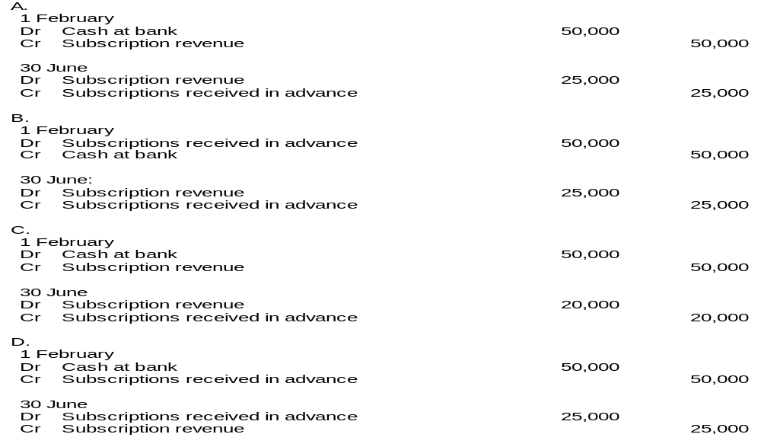
MCQs cont.

Slide 24
Expenses
‘… decreases in economic benefits during the accounting period in the form of outflows or depletions of assets or incurrences of liabilities that result in decreases in equity other than those relating to distributions to equity participants’ (AASB framework).
Let us consider this definition further …

Slide 25
‘decreases in economic benefits’
Linked to asset and liability definitions
  Outflow or depletion of assets eg. use of stationery
  Incurrence of a liability ie. a ‘present obligation arising from past event … eg. unpaid salaries
Must result in a decrease in owners equity which is not a result of payments to owners
Includes ‘losses’
Examples:‘depreciation’, salaries, telephone costs, research costs, obsolete stock writedowns

Slide 26
Events that may lead to recognition of expenses
Use of goods and services eg. Stationery, non-current assets, employees services, telephone
Passing of law eg. tax
Changed expectations eg. Development expenditure
Disasters, changing consumer tastes and technology leading to write-down or write-off of assets

Slide 27
Application of definition
A factory costing $1m is purchased for the production of furniture. The market value has decreased over the year to $.8m.
Is there an outflow or depletion of assets or the incurrence of a obligation?

Slide 28
Application of definition cont.
Denton Corporation recorded long service leave expense of $14,000. Long service leave paid during the year was $10,000.
Why is the expense different to what was paid?

Slide 29
Recognition criteria:
Probability of outflow ... (‘more likely than less likely’)
Outflow … ‘able to be measured reliably’

Slide 30
Application of definition and recognition criteria:
A manufacturing company sells goods under warranty. On 28 June a defect was found in a new product, however, no reliable estimate can be made as to the extent to which this defect will result in products being returned.
Is there a present obligation? Should costs or repairing the new product in the future be recognised in the accounts at 30 June?

Slide 31
Evaluation of definition and recognition criteria:
Definition
  linked to asset and liability concepts and therefore often subjective (lack reliability) eg.
    Is an outlay an asset or expense?
    What proportion of an outlay relates to the future?
    What proportion of a future benefit (asset) is used up?
  Encourages creative accounting
  Allocations do not reflect reality and therefore lack relevance ie. What is the financial significance of accounting ‘depreciation’ or ‘amortisation’
Recognition criteria: see income evaluation

Slide 32
Summary
Income and expense definitions are based on the definitions and measurement of asset and liabilities
  incomes are inflows or enhancements of assets or decreases in liabilities that result in increases in owners equity
  Expenses are outflows or depletions of assets or incurrences of liabilities that result in decreases in equity
Definitions and recognition criteria lack clarity and are therefore difficulty to apply
Income does not have to be earned. ‘Income’ includes ‘income’ and ‘gains’
Expenses include losses

